Slide 1
Bulk CUT&Tag Data Analysis
Hanrong Hu, Fides Zenk

Slide 2
Perquisites
Install conda
Install macs3 and deepTools:
(optional but recommended): install to specific conda environment
conda create -n epign_practical -c bioconda macs3 deeptools
Install R & Rstudio, and required packages:
ChIPseeker
TxDb.Hsapiens.UCSC.hg38.knownGene
org.Hs.eg.db

Slide 3
Bulk NGS data analysis
Glossary of NGS terms: https://deeptools.readthedocs.io/en/develop/content/help_glossary.html#
Data pre-processing
(FASTQ files)
Alignment
(SAM files)
Conversion & filtering
(BAM files)
Coverage files
(BigWig files)
Peak calling
(BED files)
Get a small(er) file to work with
What we typically get from the sequencing facility
Filter by mapping quality, duplicates etc.
Can also align to a hybrid genome (e.g spike-in, GFP)
Find regions of enrichment

Slide 4
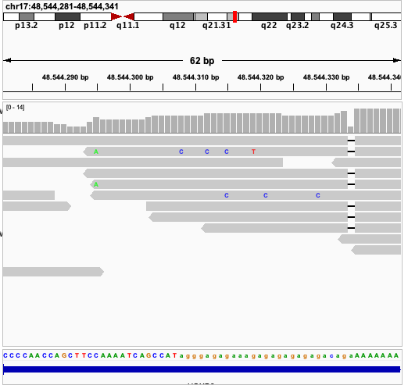
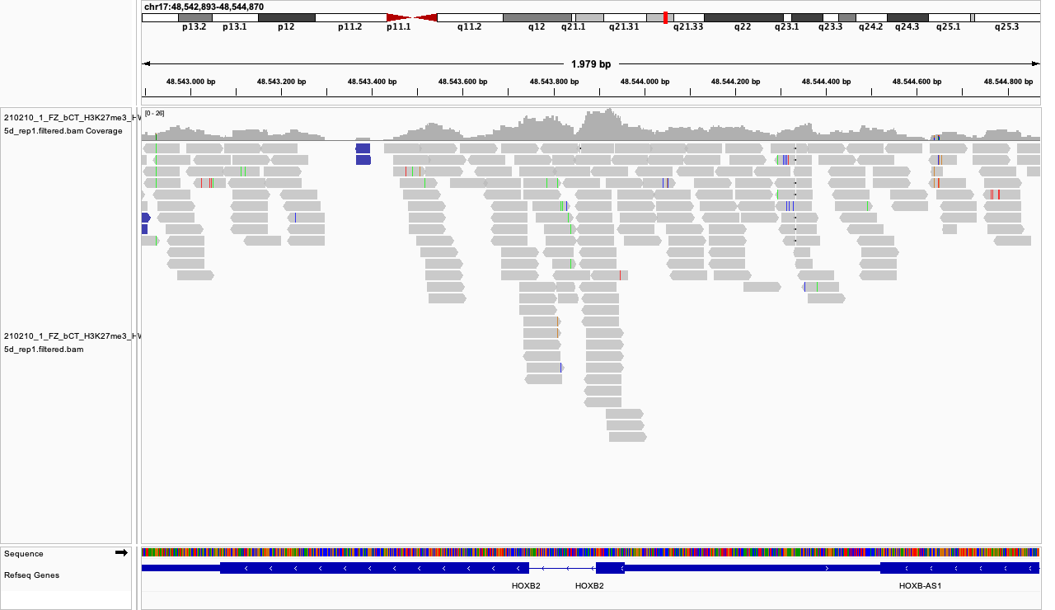
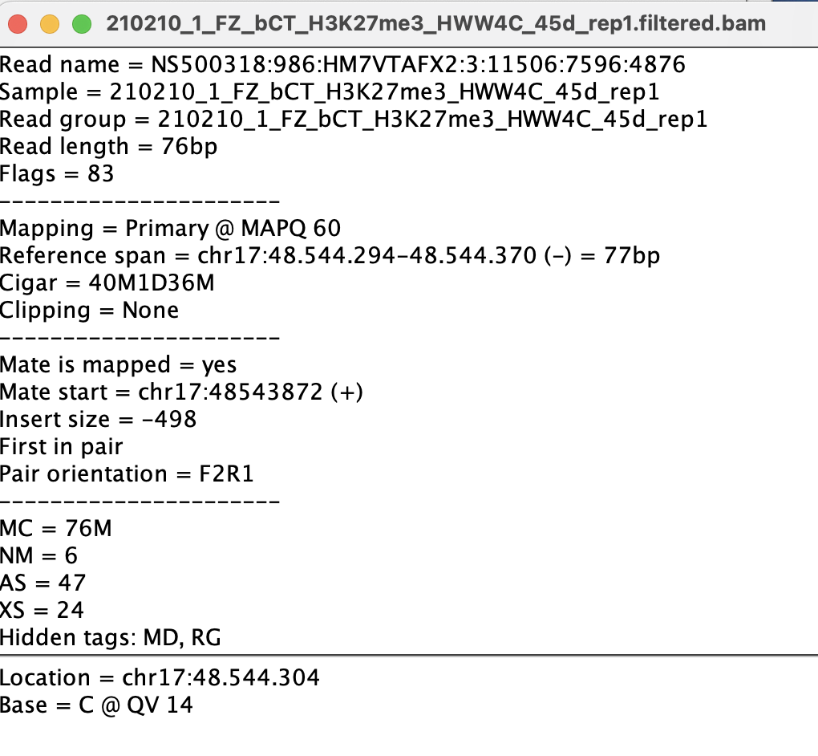
Working with BAM files (1)
Each read nucleotide seq&stats is available
Notes:
task: load a small BAM files and explore it in IGV

Slide 5
Working with BAM files (2)
BAM to BW
BigWig file format: a coverage file
Check deepTools bamCoverage
Peak calling from BAM files
Peak calling: identify areas of enriched signals
Check macs3 callpeak
macs3 callpeak -t reads.bam -f BAM --broad -g hs \
--outdir MACS3_broad_peaks -B --broad-cutoff 0.1 --nolambda
Notes:
Task: call peaks & BW files for all the bam files

Slide 6
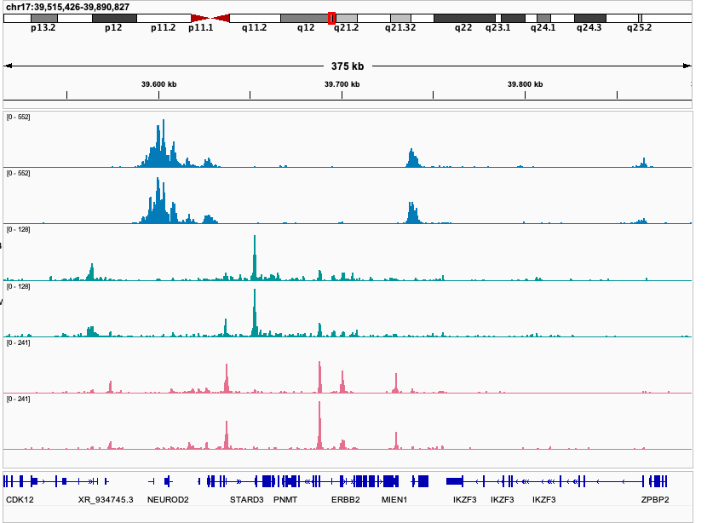
Working with BW files (1)
45d brain organoids
Load BW into IGV
Visually check BW files
Signal-to-noise ratio?
Are signals enriched in expected genomic regions?
Are replicates look good?
H3K27me3
H3K27ac
H3K4me3
Notes:
Task: load bw files to IGV and explore how they look like

Slide 7
Working with BW files (2) - deepTools
regions | sample1 | sample2
chr1:1-1000 | 0 | 10
chr1:1001-2000 | 3 | 3
… | … | …
multiBigwigSummary
get signals (BW) on regions
(tips): .npz matrix can be loaded in python
plotCorrelation or plotPCA
# from BW files
multiBigwigSummary bins -b file1.bw file2.bw -o results.npz –p max/2
# PCA
plotPCA -in results.npz -o pca.png
Example: ex vivo xenopus laevis in 96-well or air-liquid-interface
(re-plotted in python)
Notes:
Task: plot PCA on all the BW files

Slide 8
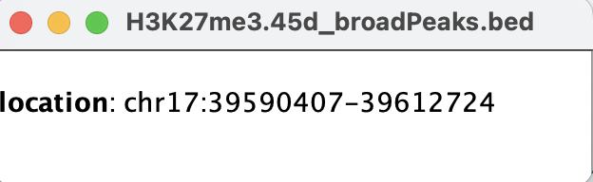
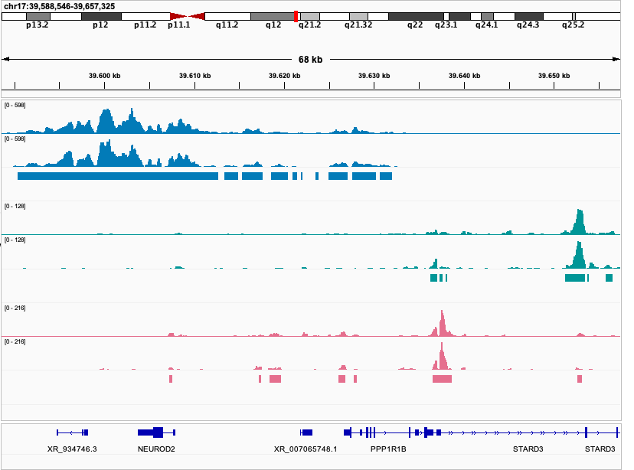
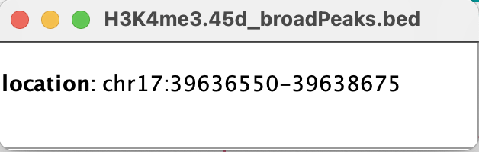
Working with peak files (1)
45d brain organoids
BED format
#chrom, chromStart, chromEnd, name …
Load peak files into IGV
Are peaks too noisy?
Does enrichment in BW fall into peak regions?
Do replicates look consistent(ish)?
H3K27me3
H3K27ac
H3K4me3
Notes:
Task: load bedfiles with the corresponding tracks

Slide 9
Working with peak files (2) - bedtools
BED file manipulation: bedtools
bedtools are also available in EPFL HPC clusters
Most common ones: intersect, merge
… but it is essentially a txt file!
# intersect >1 BED files
## check the option from manual
bedtools intersect -a file1.bed -b file2.bed file2.bed
bedtools intersect –a H3K27me3_1.broadPeak –b *H3K27me3*.broadPeak > H3K27me3.broadPeak
# merge overlapping intervels
bedtools merge –i file.bed –d 150 # two regions less than 150 bp apart will be merged
bedtools merge –i H3K27me3.broadPeak –d 150 > H3K27me3.d150.broadPeak
# select chr7
awk '$1 == "chr7"' input.bed > chr7.bed
Notes:
task: take the intersection of H3K27me3 peaks, and select for chromosome 7

Slide 10
Visualize signals (BW) on peaks
H3K27me3
H3
Cond 1
Cond 2
Cond 1
Cond 2
computeMatrix and plotHeatmap
computeMatrix reference-point \
-S coverage.bigwig -R regions.bed -o matrix.gz
plotHeatmap -m matrix.gz -o heatmap.png
H3K27me3 peaks
Check this matrix dimension:
zcat matrix.gz | head -n 2
zless matrix.gz | head -n 2
Example: mouse proximal limb ex-vivo culture
Notes:
Task: plot H3K27me3 (1) & H3K27ac (1) on H3K27me3 peaks

Slide 11
Visualize signals (BW) on other regions
H3K4me3
H3
Cond 1
Cond 2
Cond 1
Cond 2
computeMatrix with another mode: scale-region
E.g. transcriptional start site (TSS) https://reftss.riken.jp
Mouse (mm39) TSS
computeMatrix scale-regions \
-S coverage.bigwig -R TSS.bed -o matrix.gz
plotHeatmap -m matrix.gz -o heatmap.png
Example: mouse proximal limb ex-vivo culture
Notes:
task: plot H3K4me3 on TSS

Slide 12
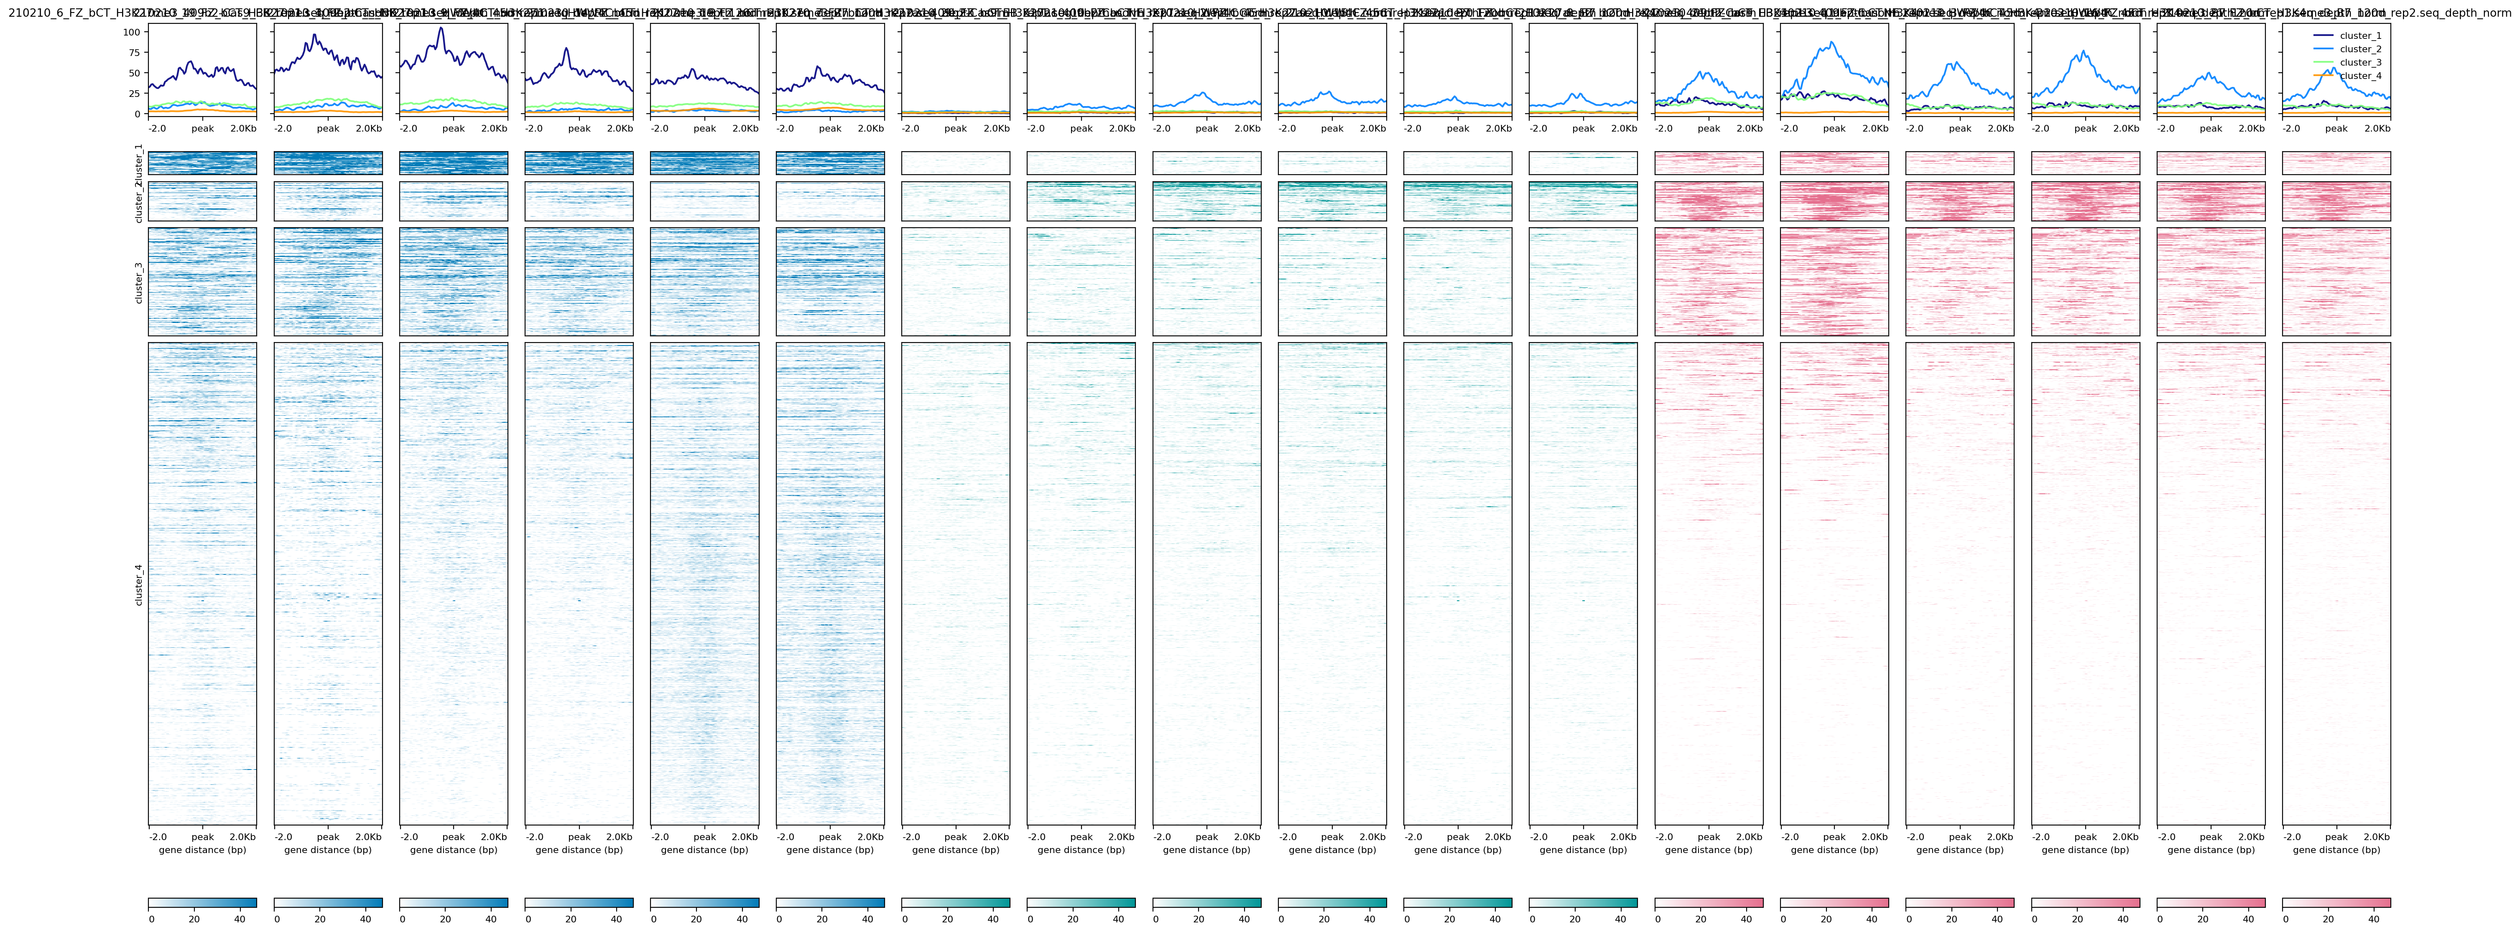
Cluster analysis
computeMatrix scale-regions -S coverage.bigwig \
-R regions.bed -o matrix.gz
plotHeatmap -m matrix.gz \
--kmeans 4 \ # other clustering algorithm possible
--outFileSortedRegions heatmap_sortedRegions.bed \
--outFileNameMatrix cluster_martrix.gz \
-o heatmap.png
Clustering of matrix.gz
H3K27me3
H3K27ac
H3K4me3
EB
d15
d45
d120
EB
d15
d45
d120
EB
d15
d45
d120
Union of H3K27me3 peaks on chr7
Notes:
Task: plot all these bws on H3K27me3 chr7. REMEMBER TO SORT BWS & cluster

Slide 13
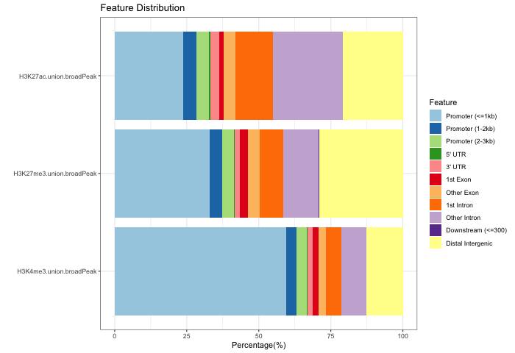
Functional annotation
From BED files to the functions
H3K4me3 peaks → promoters?
Regions with H3K27ac & H3K4me1 → enhancers ?
Regions lose H3K4me3 over development → ??
ChIPseeker in R
library(ChIPseeker)
library(TxDb.Hsapiens.UCSC.hg38.knownGene)
library(org.Hs.eg.db)
# Specify the TxDb object correctly
txdb <- TxDb.Hsapiens.UCSC.hg38.knownGene
# Convert to GRanges object and assign names
CnT.gr <- setNames(lapply(CnT.peaks, readPeakFile), peak_names)
# Annotate
CnT.anno <- lapply(CnT.gr, function(peak.gr){
annotatePeak(peak.gr, tssRegion = c(-3000, 3000), TxDb = txdb,
annoDb = "org.Hs.eg.db")
})
# Plot the stats
plotAnnoBar(CnT.anno)

